Slide 1
City and Guilds Level 1 Award in preparing to work in Adult Social Care
Sam Dawson
Course Tutor
18/1/2016

Slide 2
Aims of the lesson
Guest speaker – Lana Harber, Deaf awareness
To start Unit 5 – Awareness of the role and responsibilities of the Adult Social Care Worker.
Explore main responsibilities, relationships and daily tasks of the Adult Social Care Worker.

Slide 3
Recap on record keeping and confidentuality
In groups.
1st group – Why do we keep records?
2nd group – Why is it important to maintain confidentuality?

Slide 4
Unit 5 – Awareness of the roles and responsibilities of the Adult Social Care Worker
Develop awareness of the roles and responsibilities of the Adult Social Care worker.
Person centred care.
Daily tasks undertaken with a role.
Need for a professional approach.
Duty of care and boundaries.
Partnership working and benefits.
Adult protection.

Slide 5
Learning outcomes of Unit 5
Learning outcomes |  | Assessment criteria
1 | Know about the responsibilities of the Adult Social Care Worker | 1.1 | Identify main responsibilities of an Adult Social Care Worker.
 |  | 1.2 | Outline the responsibilities and limits of the relationship between care workers and the individual.
 |  | 1.3 | Identify others that adult social care workers may work in partnership with.
 |  | 1.4 | Outline the need to report any suspicions about abuse or neglect.

Slide 6
Learning outcomes of unit 5
Learning Outcomes |  | Assessment Criteria
2 | Know about the role of the Adult Social Care Worker | 2.1 | Identify daily tasks in a range of Adult Social Care roles.
 |  | 2.2 | Outline how duty of care might apply to the Adult Social Care worker’s daily role.
 |  | 2.3 | Give examples of how to provide person-centred support when supporting individuals in day-to-day activities

Slide 7
Roles and responsibilities
http://www.youtube.com/watch?v=OBxmqdBxsS4&feature=player_embedded
Watch the following video. Think about what are the roles and responsibilities of the Adult Social Care Worker.

Slide 8
Roles and responsibilities

Slide 9
Roles and responsibilities
Protect the rights and promote the interests of individuals and carers.
Strive to establish and maintain the trust an confidence of individuals and carers.
Promote the independence of individuals while protecting them as far as possible from danger or harm.

Slide 10
Roles and responsibilities
Respect the rights of individuals while seeking to ensure that their behaviour does not harm themselves or other people.
Uphold public trust and confidence in Social Care services.
Be accountable for the quality of their work and take responsibility for maintaining and improving their knowledge and skills.

Slide 11
Activity
In groups of 3.
How is your working relationship with the people you support different to the relationships you have with close friends?
What are the limits of the relationship between care workers and the individual.
15 minutes to complete.

Slide 12
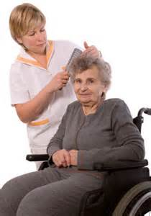
Daily tasks of the Adult Social Care Worker
Helping with personal care and supporting individuals to maintain their personal hygiene

Slide 13
Daily tasks of the Adult Social Care Worker
Serving meals and supporting people to eat

Slide 14
Daily tasks of the Adult Social Care Worker
Doing household chores, such as cleaning and laundry

Slide 15
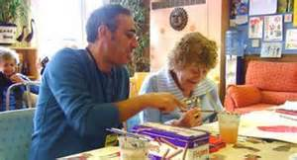
Daily tasks of the Adult Social Care Worker
Setting up activities to support individuals and supporting people with various activities

Slide 16
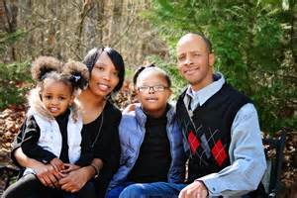
Daily tasks of the Adult Social Care Worker
Working alongside family, friends and other professionals within the setting

Slide 17
Daily tasks of the Adult Social Care Worker
Visiting professionals

Slide 18
Daily tasks of the Adult Social Care Worker
Completing and maintaining accurate and timely records

